Slide 1
Discovering Differences Between Bicycle Users
A case study of Cyclitic: Converting casual users to annual members
By Al Farrouq

Slide 2
Table of Contents
Business Question
Data Findings
Conclusion

Slide 3
Business question
How can we develop marketing strategies to convert casual users to annual members based on insights from how different users use our service differently

Slide 4
Objective
Identify the differences in bicycle use between rider types of Cyclistic, in order to focus future marketing campaigns that will convert casual users to members.

Slide 5
Data Findings

Slide 6
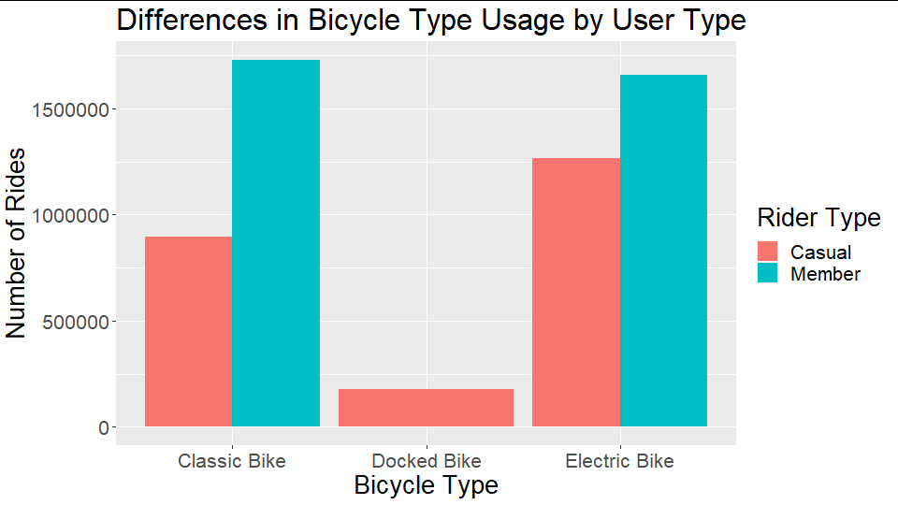
Bicycle Type
Members use Electric and Classic Bikes about equally
Casual riders use Electric Bikes more than Classic Bikes
Casual riders use Docked Bikes, while Members do not.
Notes:
I conducted analysis of different factors of bicycle usage, comparing between rider types. First, I looked at what kind of bicycle the riders used. Here we could see three main differences between casual riders and members. First, we can see that members seem to take more rides overall than casual riders. Secondly, we see that members use classic and electric bikes at about the same rate, while casual riders use electric bikes more than classic. Finally, we can see that casual riders use the docked bike, while members do not seem to use that kind of bicycle.

Slide 7
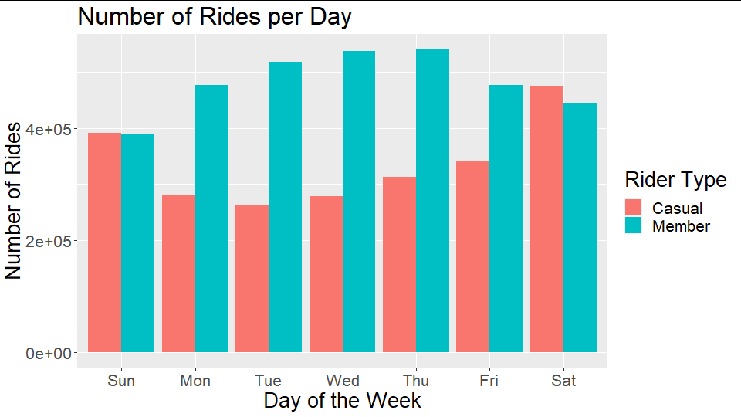
Daily Usage
Casual riders take more rides on the weekend, peaking on Saturday
Members take more rides during the week, peaking on Thursday
Notes:
Next, I decided to look at how different kinds of riders used Cyclistic’s bicycles. Specifically, I wanted to know if there was any difference in their daily usage patterns. Here we can see a graph that shows us the number of rides taken per day, on average, for both rider types. There is a clear difference casual riders and members: casual riders tend to take more rides on the weekend and later on in the week, peaking on Saturday while members tend to take more rides during the week, hitting their peak on Wed and Thu.

Slide 8
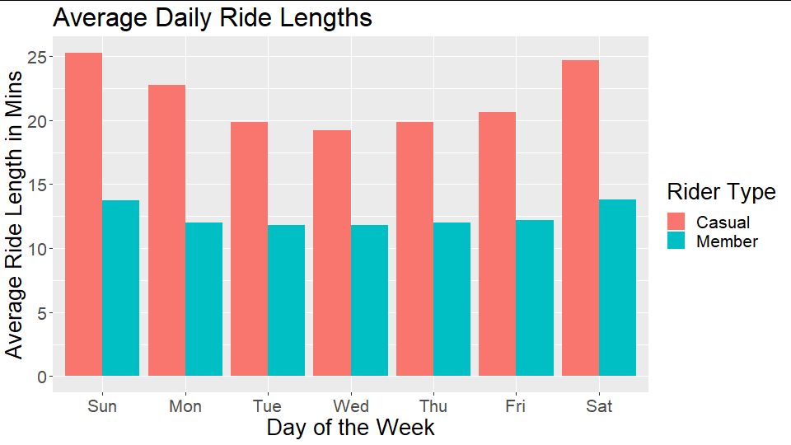
Daily Usage (cont’d)
Casual riders take longer rides on the weekend
Members also take more rides on the weekend, but lengths vary less
Notes:
To delve deeper into riders’ daily usage habits, I decided to look at the mean lengths of rides taken each day. I found that both casual riders and members tend to take longer rides on the weekend, but, as we can see, casual users have about a six minute difference between longest and shortest ride, while members only have a difference of about 2 or 3 minutes.

Slide 9
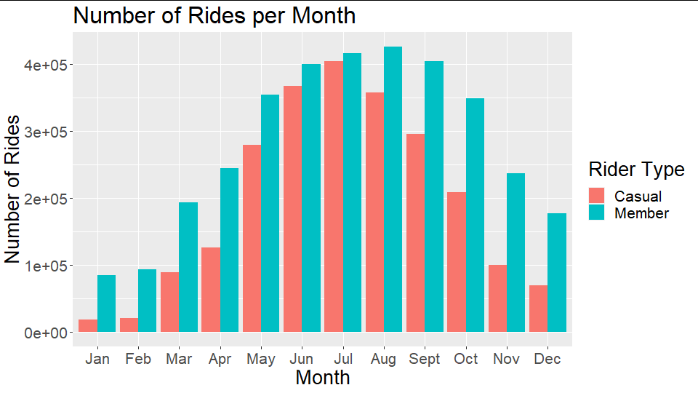
Monthly Usage
Both groups have seasonal differences
Casual riders’ rides peak in July, and fall off drastically in January and February
Members peak in August
Notes:
Zooming out from daily usage trends, I wanted to see if there were any interesting differences in rider usage per month. Here we have a graph showing the total number of rides taken each month by each rider type. We can see that both groups do have seasonal differences, but there is a bit of variance between them. Notice that the casual rider takes more rides in the summer, peaking in July, while the member has a slight shift later in the year, peaking with max number of rides in August. It’s significant to note, also, that in January and February, there is a very low number of casual users taking rides, while there are still some members riding.

Slide 10
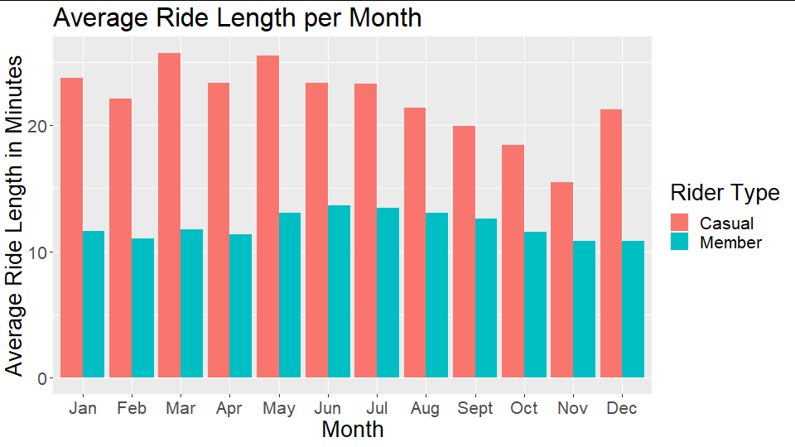
Monthly Usage (cont’d)
Casual riders’ ride length varies widely
Casual riders’ ride length peaks in March/May and falls off in November
Members have relatively uniform ride lengths
Notes:
To further investigate rider habits by month, I decided to look at the mean length of trips taken each month. Here we can see that the main interesting difference between rider types is that casual riders do have variation in their ride lengths, with a max difference of about 10 minutes between March/May and November, while member tend to have fairly uniform ride lengths, with a max difference of 2 or 3 minutes.

Slide 11
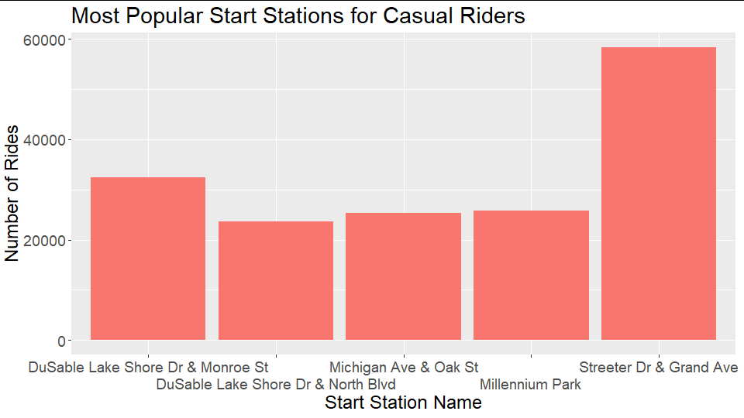
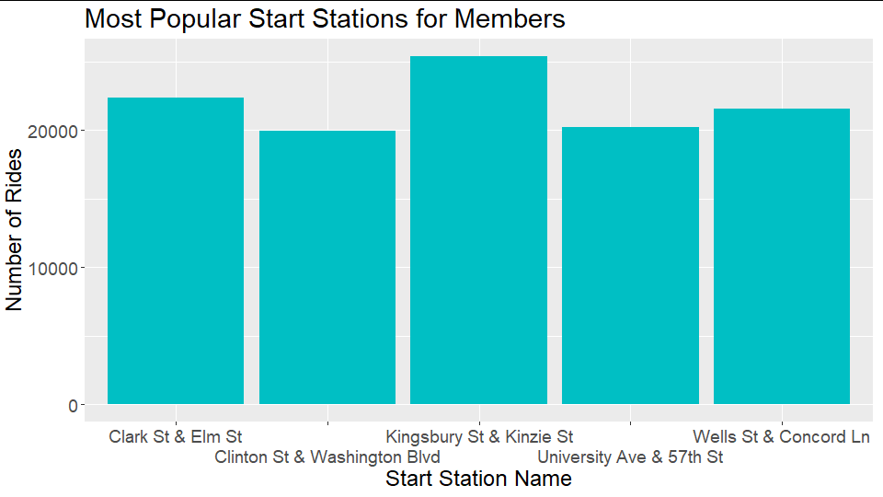
Trip Location
No overlap between groups’ Top 5 Start Stations
Casual riders start trips at Streeter Dr. & Grand Ave. 2x as often as anywhere else
Members have relatively uniform preferences
Notes:
In order to better understand if there was any notable difference between the locations where users were taking trips, I decided to look at the most popular start and end stations for each group. Here we can see the top 5 most used stations for casual riders and members. First, we can notice that there is no overlap between the stations used by each rider type, indicating that the riders DO have geographically distinct use patterns. It is also clear that casual riders start their trips at Streeter Dr & Grand Ave double the amount of time of any other bike station. Member usage is, generally, more even across their top five, but there is still a peak at Kingsbury St & Kinzie St.

Slide 12
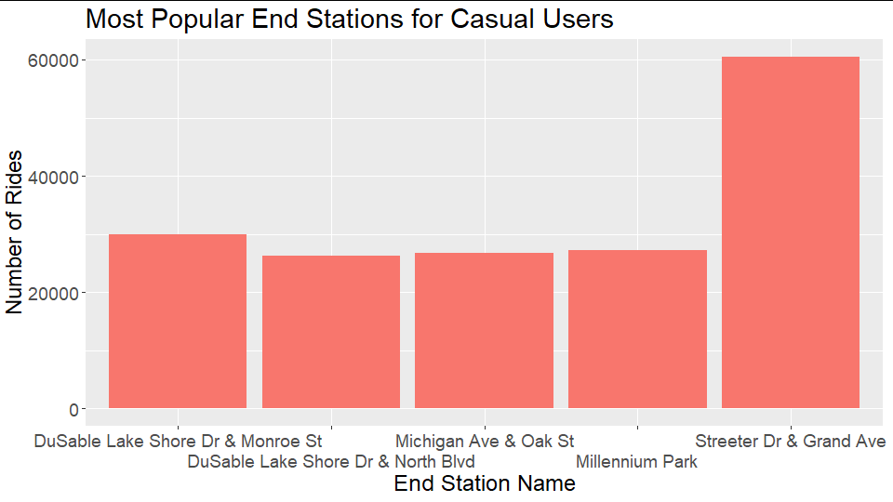
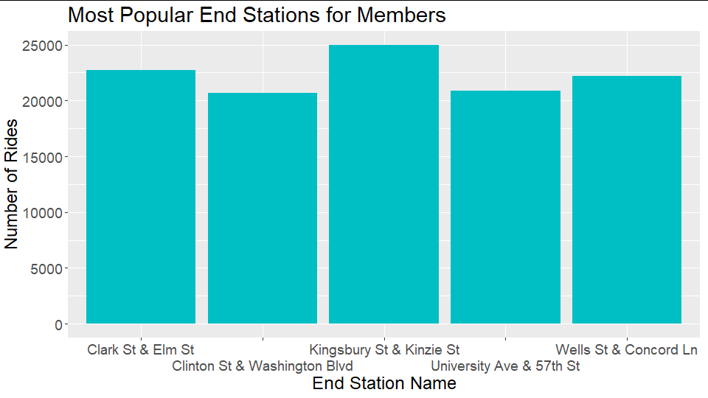
Trip Location (cont’d)
End Station trends are similar to those of Start Station
Notes:
Next, I looked at end stations, to see which were the most popular. They follow the same trends as the start stations do, with Streeter Dr & Grand Ave being the most used station for casual users by two times, and member usage being relatively uniform across their top 5. To understand what this data mean, I decided to map the stations and compare their locations.

Slide 13
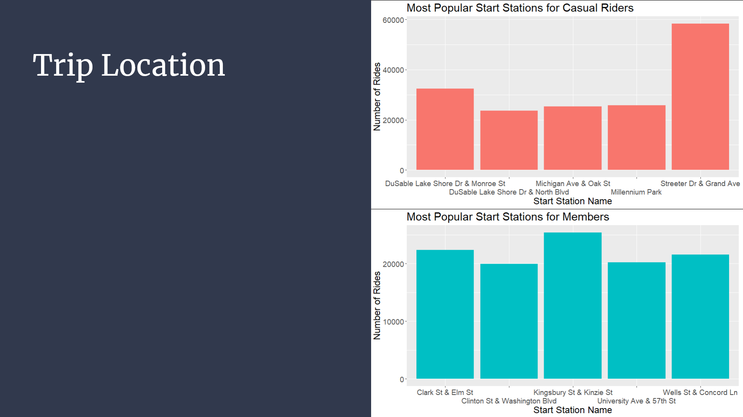
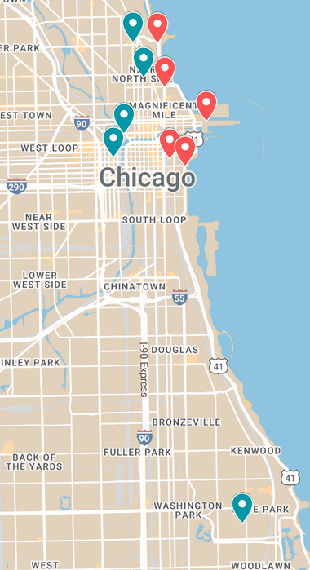
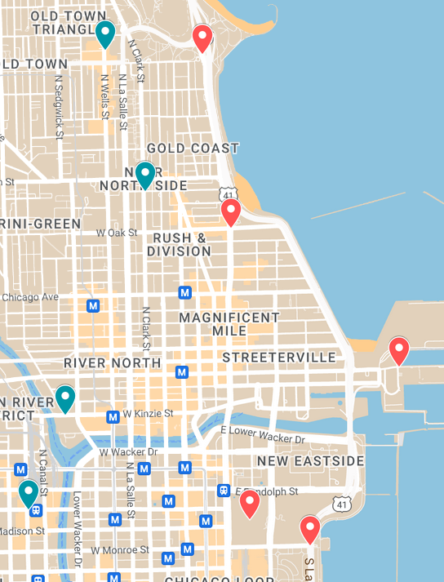
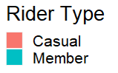
Trip Location (cont’d)
Most riders take trips in the city center
Casual riders take trips along the coast, near popular attractions
Notes:
Here we can see the top 5 most popular bike stations for both casual and member riders. The map on the left shows all 10 stations, and the one on the right is a zoomed in version of the city center, where 9 of the 10 stations are located. These maps show us that, in general, casual riders are taking trips more towards the eastern part of the city, where the lake and attractions are, whereas members take trips more in the interior of the city and near the University.

Slide 14
Conclusion
Notes:
Now, based on these data, I turn to my conclusions.

Slide 15
Rider Habits
Casual
Prefers Electric Bikes
Uses Docked Bikes
Rides more often and longer on weekends and in summer
Member
No Electric/Classic preference
Does not use Docked Bikes
Rides equally throughout week, peak use in fall
Notes:
First of all, we can make some generalizations about rider habits. Casual riders prefer Electric Bikes over all others, and also use Docked Bikes. They also tend to ride more often and longer on weekends and in the summer. Members, on the other hand, don’t exhibit a preference in terms of Electric/Classic bikes, but don’t use Docked bikes. They ride essentially equally through the week, with their peak use in the early fall.

Slide 16
Rider Habits (cont’d)
Casual
Uses coastal stations near attractions
Strong preference for Streeter Dr. & Grand Ave.
Member
Uses interior and University stations
Notes:
In terms of location, we can say that casual users use stations near the lake and close to attractions, with a strong preference for the Streeter Dr & Grand Ave. station, while members use interior and University stations more often, and with no clear top preference.

Slide 17
Rider Profiles
Casual
May represent visitors to the city or residents at leisure time
Member
May represent commuters, such as workers or students
Notes:
All of this information suggests that casual users may represent visitors to the city or residents who use Cyclictic bikes primarily in their leisure time, while members, who use bikes more uniformly, may be commuters, such as workers or students.

Slide 18
Recommendations
To reach target audience:
Focus print advertising on coastal areas, near attractions (especially Streeter Dr. & Grand Ave.)
Emphasize summertime and leisure activities in ad visuals
Advertise on electric bikes
Notes:
So, based on all of the above analysis, my recommendations for future advertising campaigns would be as follows. In order to reach the target audience, or casual riders, it will be important to focus print ads on coastal areas near attractions, and especially near Streeter Dr. & Grand Ave. This is where most casual riders take their trips. In advertisements, using summertime and leisure activity imagery could be appealing to casual users, as it seems they have preference for summer and weekends. Finally, if possible, I would recommend putting ads on the electric bikes, as casual users use them more than classics. These three strategies should be able to more effectively target casual users and help convert them to members.

Slide 19
Questions?
Notes:
Thank you for your time, and with that I’ll take any questions.

